Slide 1
Software Development Tools & Practices
PUSL2020
Level 2
“Introduction to Web Technologies”
Dr. Rasika Ranaweera (ranaweera.r@nsbm.ac.lk | +94 11 544 6126)
Faculty of Faculty of Postgraduate Studies & Professional Advancement | NSBM Green University

Slide 2

Overview
Introduce the module
Core principles
Tools in use
Revision – HTML, CSS, JavaScript
Notes:
What is internet and WWW?
HTTP, MVC

Slide 3
Web Technologies
Server side technologies
  ASP.NET, JSP, PHP, Python, RoR etc.
Implement server-side solution integrated with data store
  MySQL & SQL Server
Web Frameworks & Open source
Test & Secure
Notes:
Working in the web world you need to flexible and adaptable. This is why we teach core principles using languages - rather than teach you languages.

Slide 4
Core Principles
What is a web page?
URI’s & URLs
Architecture
HTTP headers
Notes:
We talk in terms of delivering core principles. And for this module I suggest that this summarises those core principles. If you understand the underlying structure of the networks the internet travels over, the underlying structure of how a web page is created, the underlying structure of how you refer to elements online as well as the whole architecture - the http response & request mechanism being core. If you understand these things, when things change, when new languages appear, when new frameworks emerge, you will be able to cope.

Slide 5
Static vs Dynamic web pages
A STATIC WEBSITE
A DYNAMIC WEBSITE
A static website is the simplest kind of website you can build.
Static websites are written in HTML and CSS only, with no scripting.
The only form of interactivity on a static website is hyperlinks.
A dynamic website is a website that not only uses HTML and CSS, but includes website scripting as well.
There are two main reasons why you’d want to use website scripting on your site:
  you want an interactive web app that people can use, not just read
  you want to be able to share HTML code between your pages.
Notes:
So what is a web page made of?
What makes a web page dynamic?
With your neighbour make a list of what technologies are behind a dynamic web page.

Slide 6

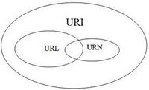
URIs, URLs & URNs
Uniform Resource Identifier
  Identifies a “thing” on the web
Uniform Resource Locator
  A URI that starts with http
  A URL contains information that directs a browser to the resource that the user wishes to access.
  Web servers make such resources available to web clients.
Uniform Resource Name
  The URN is the “globally unique” part of the identification; it’s a unique name.
  Ex: urn:isbn:0451450523
Notes:
URLs can refer to files, directories or server side code which can perform a specific task, perhaps a database look up. Once you know the URL you can enter it into any browser and get to it.

Slide 7
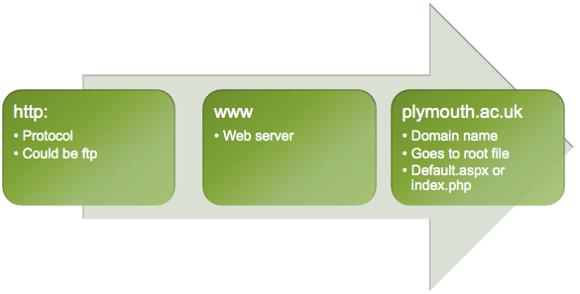
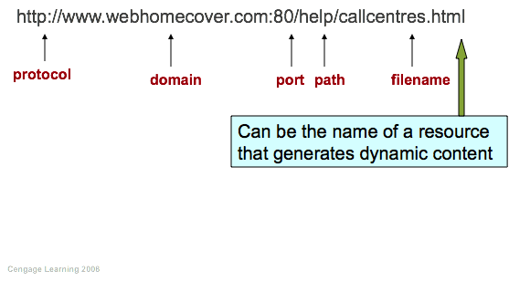
Notes:
The URL is the complete the location of the internet resource.
The protocol of the request is at the front - usually http, but could be ftp
Then there is a reference to the server, so this can be a domain or an IP address.
Sometimes you might have a port number - in our example here we have port 80. There have been times we have to use 8080 in the lab, and if any of you run Mamp on a Mac then you will see the local host with port 8888. http protocol normally goes out on port 80, if you are using the secure socket layer, then you’re going out on port 443.
There may be a subdirectory path - remember also our tulip folder, sub folder modules. Here it’s help.
Then you get the name of the resource itself - the actual filename of the page that is going to do the processing.
Now, what happens when you just go to the folder? What about www.plymouth.ac.uk? What happens there?
A: index.x

Slide 8
Exercise
ftp://ftp.is.co.za/rfc/rfc1808.txt
http://www.ietf.org/rfc/rfc2396.txt
ldap://[2001:db8::7]/c=GB?objectClass?one
mailto:John.Doe@example.com
news:comp.infosystems.www.servers.unix
telnet://192.0.2.16:80/
urn:oasis:names:specification:docbook:dtd:xml:4.1.2
tel:+1-816-555-1212 (?)
URL: ftp://ftp.is.co.za/rfc/rfc1808.txt
URL: http://www.ietf.org/rfc/rfc2396.txt
URL: ldap://[2001:db8::7]/c=GB?objectClass?one
URL: mailto:John.Doe@example.com
URL: news:comp.infosystems.www.servers.unix
URL: telnet://192.0.2.16:80/
URN (not URL): urn:oasis:names:specification:docbook:dtd:xml:4.1.2
URN (not URL): tel:+1-816-555-1212 (?)
Notes:
URLs can refer to files, directories or server side code which can perform a specific task, perhaps a database look up. Once you know the URL you can enter it into any browser and get to it.
Let’s take an example.
Our tulip site. Type in https://tulip.plymouth.ac.uk/Module/COMP216/SitePages/Home.aspx
and you get to the folder. Some of you may get used to clicking the hyperlink, but once you know what this URL is doing....

Slide 9
IP Addresses
Routers “glue” all the IP addresses together
Important concept to remember
IP convert to domain names
Domain Name System (DNS) allows domain names to be resolved to the correct IP address.
The format of an IP address is a 32-bit numeric address written as four numbers separated by periods. Each number can be zero to 255. For example, 1.160.10.240 could be an IP address.

Slide 10



HTTP Request
Client
Server
www.plymouth.ac.uk
HTTP Response
instructions
<html> ....</html>
Notes:
Client can be any type of machine that has a browser. Smart phone, laptop, tablet, desktop etc.
By typing in the URL you are making the browser create an http packet of data.
this is the HTTP Request.
the server knows what to do with that request.
it replies with a packet of data which has some instructions in it (headers) and the html that will display.
Where our coding comes in is in how the server creates that html

Slide 11



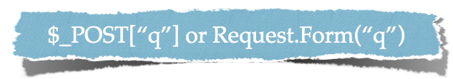
HTTP headers
Additional information is provided in the HTTP headers.
  The information provided in the header specifies the Multipurpose Internet Mail Extensions (MIME) type of the content that the server is transmitting to the browser.
  The MIME standard specifies data formats, which programs can use to interpret data correctly.
Provides information about what the file is that the server is sending to the client (MIME type).
HTTP Request types
  Get
  Post
Notes:
Mime type = Multipurpose Internet Mail Extension
Allows you to interrogate the header and work out what to do with the file that is being delivered.
Most common request types are get & post
HTTP request often posts data to a server and the server side programming processes the data.
Each of these requests handles the data in different ways.
A GET request appends the data to the URL -
A Post request sends the form data directly as part of the http message - it does not get seen in the URL.
Where might this be useful?
Do remember however that just because the user cannot see the data by default, it does not mean that people cannot get to it. There are tools that allow the post data to be seen! If you need to make sure something is secure - use a secure protocol.
So you’ve posted it, how do you get to it?
In PHP you get to it via superglobals $_GET, $_POST. There are other methods, but we shall leave them for the moment.
In ASP.NET you use the Request object - this is the object that has come in. And for Get you use the property on that object - Querystring. For Post there is a property called Form.

Slide 12
HTTP get and post Requests
The two most common HTTP request types are get and post.
A get request typically gets (or retrieves) information from a server, such as an HTML document, an image or search results based on a user-submitted search term.
A post request typically posts (or sends) data to a server.
Common uses of post requests are to send form data or documents to a server.
An HTTP request often posts data to a server-side form handler that processes the data.

Slide 13
HTTP get and post Requests (Cont.)
A get request appends data to the URL, e.g., www.google.com/search?q=deitel.
The server uses data passed in a query string to retrieve an appropriate resource from the server.
The server then sends a response to the client. A get request may be initiated by submitting an HTML form whose method attribute is set to "get", or by typing the URL (possibly containing a query string) directly into the browser’s address bar.
A post request sends form data as part of the HTTP message, not as part of the URL.
A get request typically limits the query string (i.e., everything to the right of the ?) to a specific number of characters, so it’s often necessary to send large amounts of information using the post method.
The form data still reaches the server and is processed in a similar fashion to a get request, but the user does not see the exact information sent.

Slide 14
Stateless
Client makes request to server
Server does not remember what got sent before
Client runs browser software, uses http to request pages from server
Server listens for clients asking for pages so runs server software
  Apache
  IIS
Server transmits status code, web page and associated files
Notes:
A key point!
Client & server is the term given to how two computers are interacting. Individuals use a number of different clients to access data held on a server.
IPhone, iPad, HTC, Laptop, PC

Slide 15
Client-Side Scripting versus Server-Side Scripting
Client-side scripting with JavaScript can be used to validate user input, to interact with the browser, to enhance web pages, and to add client/server communication between a browser and a web server.
Client-side scripting does have limitations, such as browser dependency; the browser or scripting host must support the scripting language and capabilities.
Scripts are restricted from arbitrarily accessing the local hardware and file system for security reasons.
Another issue is that client-side scripts can be viewed by the client by using the browser’s source-viewing capability.

Slide 16
Client-Side Scripting versus Server-Side Scripting (cont.)
Programmers have more flexibility with server-side scripts, which often generate custom responses for clients.
For example, a client might connect to an airline’s web server and request a list of flights from Boston to San Francisco between April 19 and May 5. The server queries the database, dynamically generates an HTML document containing the flight list and sends the document to the client. This technology allows clients to obtain the most current flight information from the database by connecting to an airline’s web server.
Server-side scripting languages have a wider range of programmatic capabilities than their client-side equivalents.

Slide 17
IIS web server
Automatic with some versions of windows
Set up through the control panel – Program Features
Documents for serving on web go into c:\inetput\www
  or you create a virtual directory
Notes:
A virtual directory being an alias for the files being somewhere else.

Slide 18
Web servers - Apache
Open source software
Runs on Unix, Linux, Mac & Windows
Comes as a bundle with PHP & MySQL (WAMP, XAMP etc)
Documents served from default directory
  htdocs
  www
Notes:
www on windows
again can set up virtual directories
There are host of other web servers, but these two are the ones we are concerned about.

Slide 19
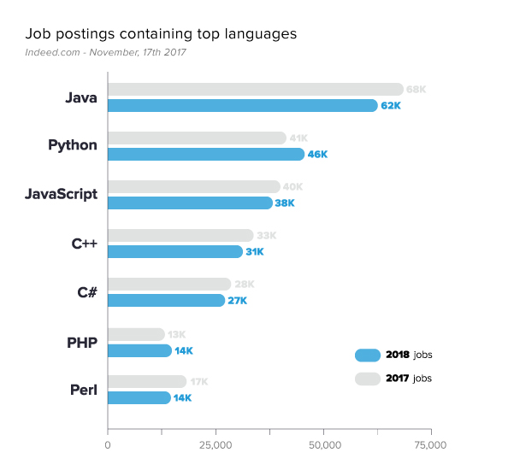
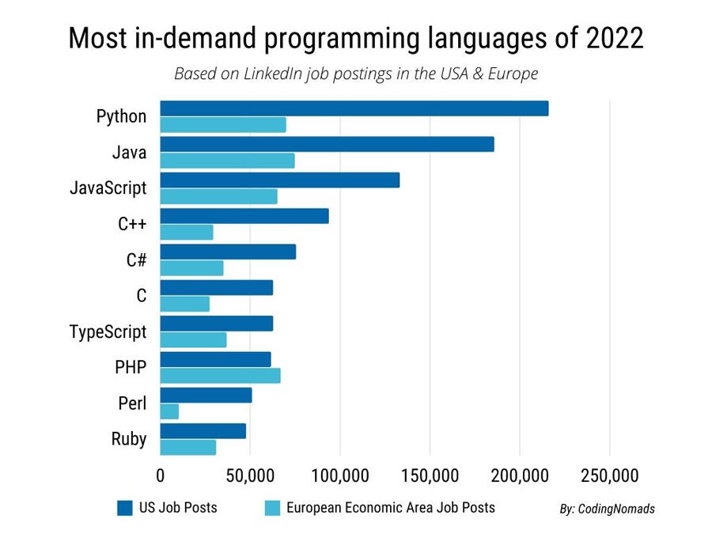
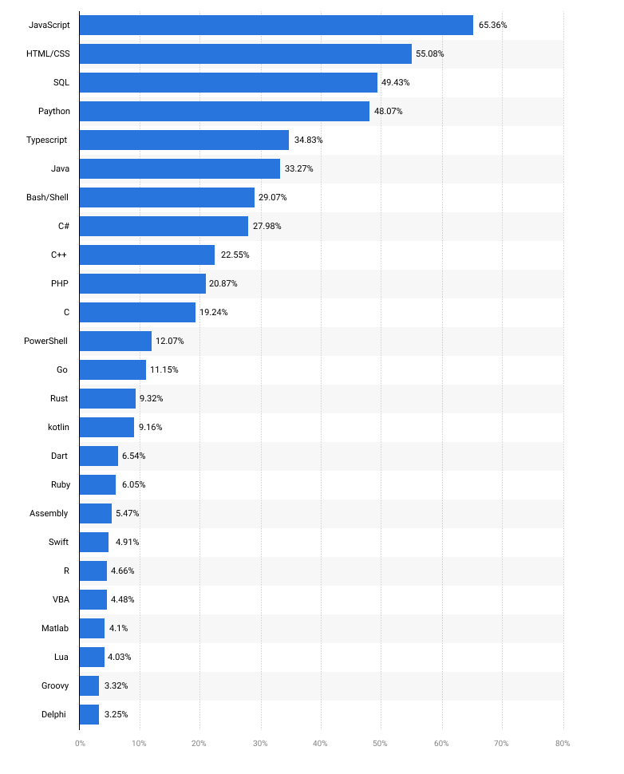
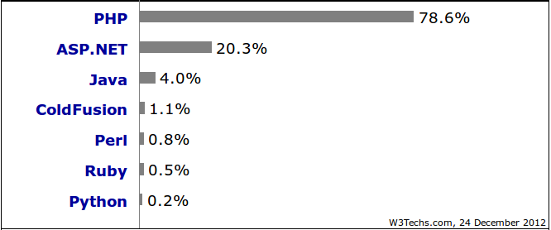
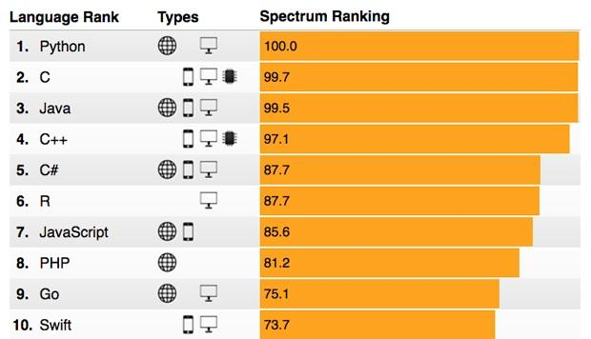
Server-side programming languages comparison
In-Demand Programming Languages in 2024

Slide 20
 | PHP | ASP.Net | JSP | Python
Developer | The PHP Group | Microsoft Corporation | Adobe (previously Macromedia) | Python Software Foundation
Cost | Free download and hosting on open-source Linux server. | Free download but possible Windows hosting cost (although see Operating System comparison below). | Free download and hosting on open source Linux server. | Free download and hosting on open-source Linux server.
Ease of use | Simple, text based language with numerous online tutorials. | Easy to use particularly with Microsoft’s integrated development environment software, WebMatrix. | More complex to learn. Also, using JSP requires some knowledge of Java programming language. | Programming language. More complex to learn but voted best language for beginners serious about learning programming.

Slide 21
 | PHP | ASP.Net | JSP | Python
Implementation language | C based language. | .NET languages | Java language | C/C++ based languages and Java language.
Operating system | All modern operating systems including mobile platforms (iOS and Android). | Platform dependent –Windows operating system required to develop in ASP.NET | All modern operating systems including mobile platforms (iOS and Android). | All modern operating systems.

Slide 22
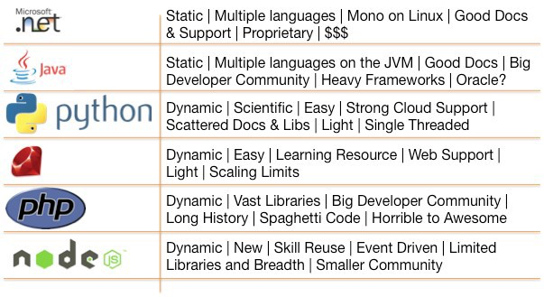
Immerging Technologies

Slide 23
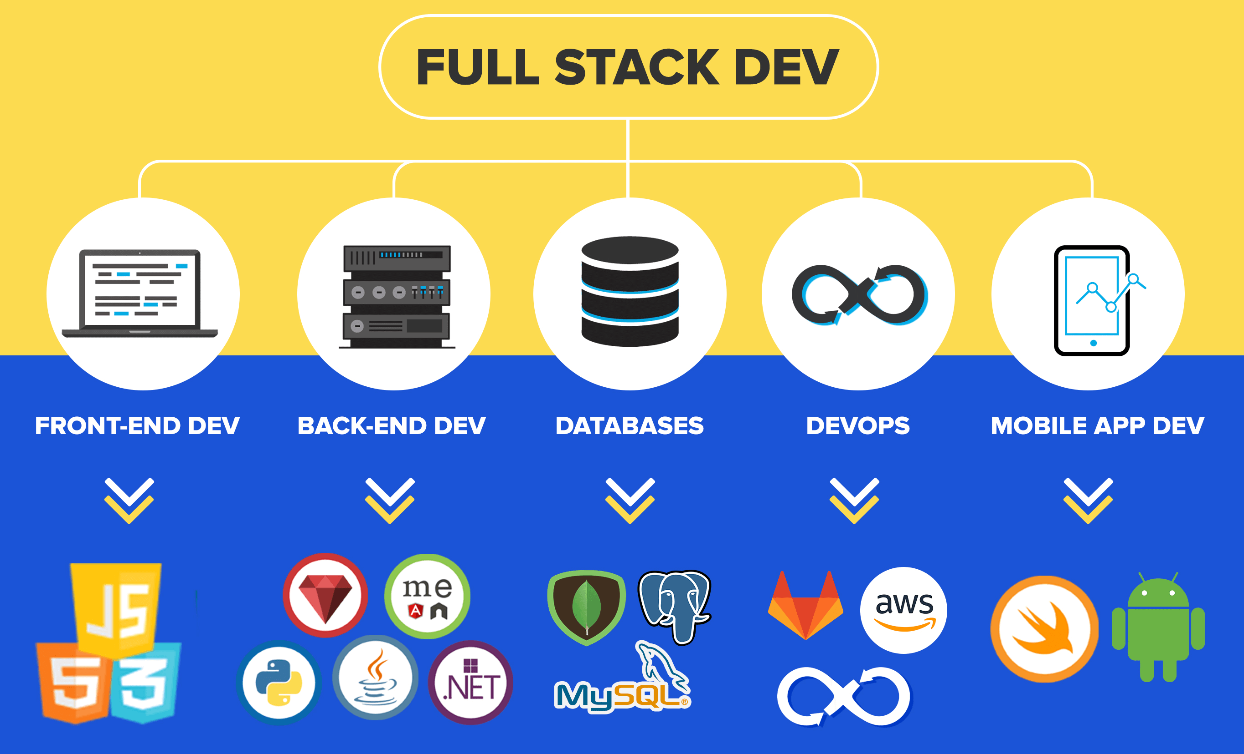
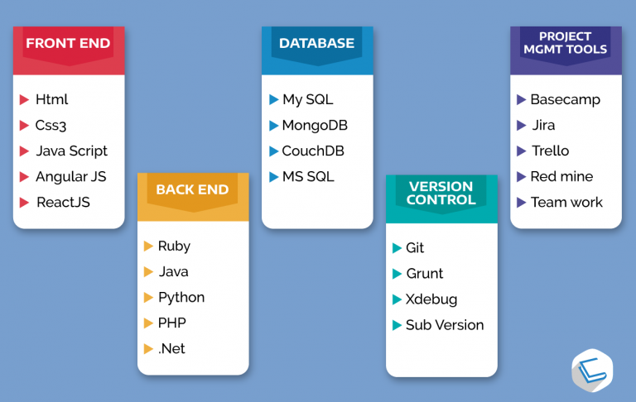

Slide 24


Tools
Notes:
This module is about server side programming
There are a whole host of programming languages that fit into this
We are going to concentrate on two of the most popular - PHP & ASP.NET. Many of you will be studying Java with Mary.... so you will have quite a toolkit of languages when you go out on placement.
Some of you might be wanting to concentrate on one language as you may feel you can’t get into one deeply enough. This is a mistake. If you wanted to just learn a language - then you should be doing an industry course - most of the time employers want to know that you can programme, they expect you to hone and develop your skills later.
We will be using Visual Studio 2010 Ultimate and Netbeans 7.1.

Slide 25
Revision – HTML,CSS, JavaScript
Write the HTML and CSS code necessary to recreate the following appearance onscreen. (No manual line breaks have been inserted into the text.) Assume that the code you're writing will be placed inside the body of the page. You should also write valid code that would pass the W3C validators, and separate stylistic information from HTML.
Some details about the desired appearance:
  • All text uses default sizes and font families.
  • The central section of dialogue is centered within the page and occupies 50% of the page width.
  • The image of Vader at right comes from the file vader.png, which you should set to 20% of the page width.
  • There are no margins or padding separating any text.
  Mark up the text on the next page with your HTML tags. If a tag can't physically be written in the space provided, write it in the margins and draw an arrow to where it should be inserted in the text. Write the CSS styles on the page after next.

Slide 26
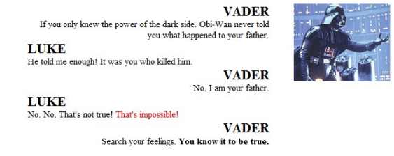
Revision – HTML,CSS, JavaScript (Cont.)

Slide 27
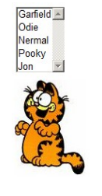
Revision – HTML,CSS, JavaScript (Cont.)
Write the Javascript code to fill the selection box below with the following five choices: Garfield, Odie, Nermal, Pooky, and Jon. When the selected item in the box changes, the image below the selection box changes to display a picture of the character. The images are located in the images/ subfolder from the web page and are saved in JPG format with file names matching the character names.
After your Javascript code runs, the appearance and behavior should be the following

Slide 28
Next week
Page lifecycles
Identity management
Linking to data sources

Slide 29
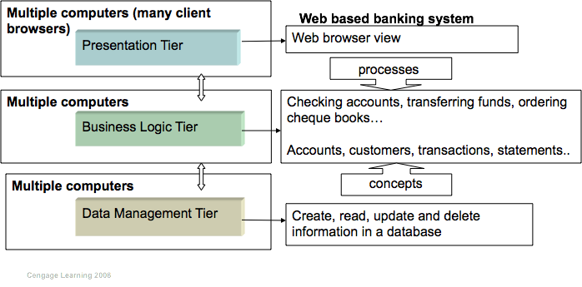
Coding Architecture
Notes:
This examples shows you how the architecture is utilised in an example like a banking system.

Slide 30
Helpful Links
www.w3schools.com
  HTML
  CSS
  JavaScript
https://www.linkedin.com/
  Web Development Foundations: Web Technologies

